Slide 1

DIGIWEAVE:DIGITAL SKILLS DEVELOPMENT PROGRAMME FOR KENTE WEAVING COMMUNITIES (BONWIRE)
By ELLEPM

Slide 2
Order of Presentation
Background
Project Justification
Project Purpose and Objectives
Project Benefits
Scope
Success Criteria
WBS
Milestone Schedule
Resource Identification
Communication Plan
Risk Register
Procurement
Conclusion

Slide 3

Background
Kente is one of the most widely recognized fabrics in the world
The fabric is typically woven in communities that are dedicated its production
Its popularity has led to some of these settlements becoming tourist attractions such as Bonwire.

Slide 4
Project Justification
The production of Kente is an ancient practice and should have developed significantly over the years.
However, the kente weaving industry in Bonwire faces a number of challenges that has slowed down its progress leading to the decline of the industry and a lack of development in the area (King et al., 2024).
According to Meena et al. (2023) the weaving/textile industry is likely to interact with digitization and technology within the next decade.
It is therefore imperative that the industry is transformed to promote the economic livelihoods of the people while also preserving the rich history of the practice.

Slide 5
Project Purpose and Objectives
Goal:
To provide essential digital and entrepreneurial skills to the youth involved in kente production in Bonwire
Objectives:
To develop a training programme for weavers, sewers and sellers for digital and entrepreneurial training in the community.
To equip 100 kente youth weavers with fundamental digital and entrepreneurial skills to enhance creativity, productivity, marketing and overall efficiency in kente production

Slide 6
Project Benefits
Positive economic impact.
Youth armed with digital and entrepreneurial skills.
Enhanced efficiency of kente production and commercialization.
Expansion of market for kente.
PROJECT BUDGET
The project budget is: $ 300,000 (Analogous Estimation)

Slide 7

Scope
The project will include the creation of a structured and interactive digital skills development curriculum, provision of devices for use during program, workshops and practical sessions.
PROJECT DELIVERABLES
DELIVERABLE NO. | DESCRIPTION
1 | Community Awareness
2 | Digital infrastructure set up
3 | Digital and Entrepreneurial Skills Training Curriculum
4 | Training

Slide 8

Success Criteria
A digital and entrepreneurial training program developed that can be adopted for subsequent sessions.
The project should be completed within budget, within the allocated time and with the selected scope being achieved.
100 kente weavers empowered with digital and entrepreneurial skills.

Slide 9
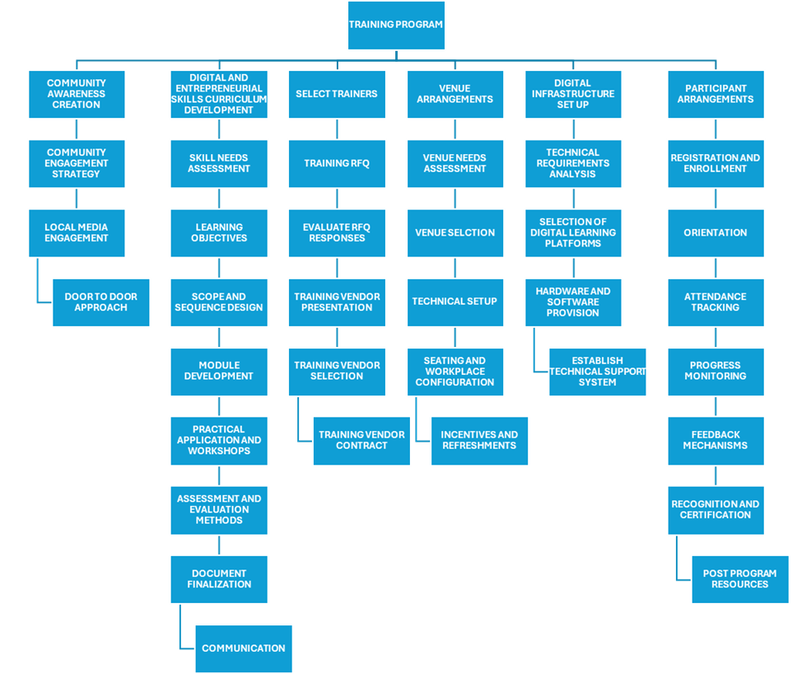
WBS

Slide 10
Milestone Schedule
Milestones | Due Date
Project Start | 04/03/2024
Stakeholder Consultation | 15/03/2024
Initial curriculum framework development | 05/04/2024
Funding | 08/04/2024
Awareness Creation | 15/04/2024
Procurement | 12/06/2024
Venue Arrangements | 26/06/2024
Completion of digital and entrepreneurial skills curriculum | 10/07/2024
Digital Infrastructure Set up | 10/07/2024
Participant Arrangements | 26/07/2024
Program end | 08/11/2024
Project End | 25/11/2024

Slide 11
Resource Identification
Requirements | Skills Needed | Role | Qualifications | Experience
Contract documentation | Financial Analysis Understanding of Contract law Strong understanding of agreements Negotiation skills and planning | Finance Manager | Certified Public Accountant or Chartered Accountant | Minimum 8 years
 |  | Procurement Manager | Degree or higher | Minimum 5 years
Procurement Plan | Negotiation skills and planning Cost Management skills Contract Management Skills Strategic Sourcing Skills Financial Knowledge | Procurement Manager | Degree or higher | Minimum 5 years

Slide 12
Communication Plan
DELIVERABLE INFORMATION | RECIPEIENT | PURPOSE | DELIVERY MEDIUM | FREQUENCY | OWNER | DELIVERABLE DOCUMENT
Initiation Meeting | All Stakeholders | To gather initial information for the initiation plan | Meeting (Face to face) | First Meeting before the project start date | Project Manager | Agenda Meeting Minutes
Distribute Project Initiation Plan | All Stakeholders | Distribute plan to alert stakeholders of the project scope and to gain their buy in. | Emails Hard copy delivery | Before Kickoff meeting | Project Manager | Project Initiation plan
Kickoff Meeting | Project Sponsor Project Team Stakeholders | Introduce the project team and the project. Review project objectives and management approach. Communicate plans and stakeholder roles/responsibilities | Meeting (Face to Face) | Near Project Start Date | Project Manager | Agenda Meeting Minutes

Slide 13
Risk Register
Project | Training project
last updated
 |  |  | Rank from 1 lowest to 5 highest | Rank from 1 lowest to 5 highest
Risk ID | Description | Trigger | Probability | Impact | Score | Owner | Response | Response Strategy | Expected Results | Status | Notes
1 | Limited internet access |  | 3 | 3 | 9 | Project Manager | Mitigate risk | Assess internet access through a survey, Provide offline resources where possible
2 | Resistance to Digital change |  | 2 | 5 | 10 | Project Sponsor | Mitigate risk | Implement a comprehensive change management strategy, including awareness campaigns and workshops
3 | Budget overruns |  | 2 | 4 | 8 | Finance Manager | Mitigate risk | Detailed Budget Development with contingency funds and management reserves, Regular monitoring

Slide 14
Procurement
PROCUREMENT ENTITY: ELLEPM
Contract Package | Plan vs Actual | Package Number | Procurement Method | Contract Type | Tendering Period and Evaluation | Contract Finalization
Training | Plan | ELL/CH/SER/001/24 | RFQ | FFP |  | 10/05/2024
 | Actual
Digital Infrastructure Set up | Plan | ELL/CH/GDS/001/24 | NCT | FFP |  | 08/07/2024
 | Actual

Slide 15
M and E
ELLEPM
ACTIVITY | OUTCOME | PURPOSE | INDICATOR | UNIT OF MEASURE | DATA COLLECTION SOURCE | DATA COLLECTION METHOD | FREQUENCY | RESPONSIBLE PERSON
Awareness Creation | Digital Change Accepted | Awareness creation is carried out to ensure that potential participants understand what the program is about, the benefits they would gain and encourage them to participate. | Percentage of people reached | Percentage | Primary | Using the M&E questionnaire and checklist | Weekly | Project Manager
Curriculum Development | Digital and Entrepreneurial Skills Curriculum Developed | To provide a structured and comprehensive framework for the training | Percentage of curriculum completed | Percentage | Primary | Using checklist | Weekly | Curriculum Developer

Slide 16
Conclusion
Incorporating digital technology into the kente design and production process is the future.
By building the digital and entrepreneurial skills of the future faces of the kente industry, the next generation of weavers will be empowered with the tools and knowledge needed to thrive in a rapidly evolving global market.

Slide 17

Thank You

